Slide 1

A user’s guide to user authentication
Presented by: Christina Nguyen, Michael Bloomquist, Sarah Ramazani, Travis Lamb

Slide 2
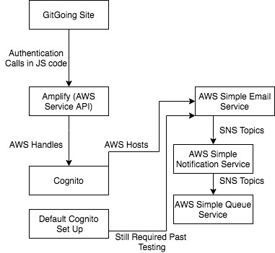
Cognito Site Implementation
React JS
Authentication Calls
Site Needs:
Authentication
Security
AWS Amplify
Amazon Cognito
Email service
Queue service

Slide 3
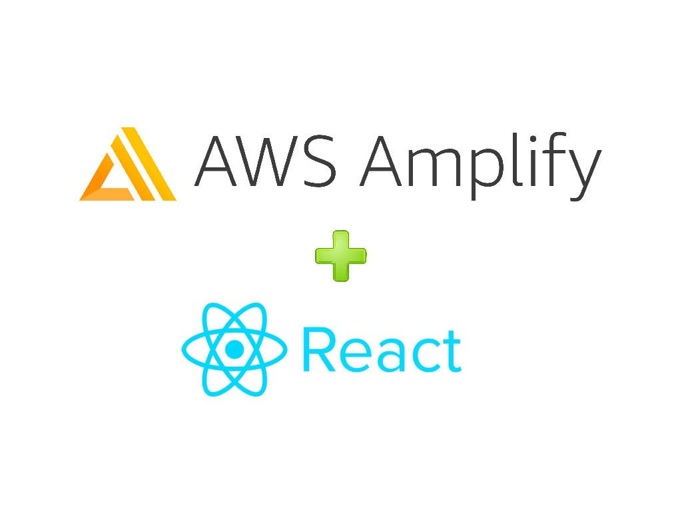
Introducing Amplify
Amazon Web Services (AWS)
Offers remote cloud services
Amplify
Helps build scalable full-stack applications
Open source libraries
UI Components

Slide 4
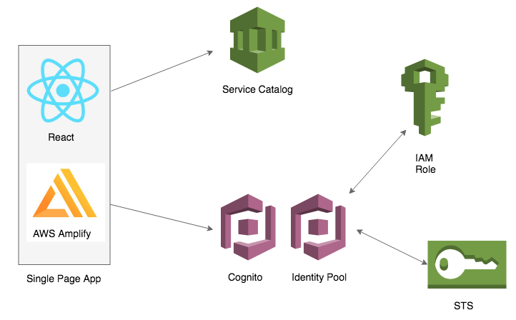
Introducing Cognito
provides authentication, authorization, and user management
2 main parts: user pools and identity pools
User Registration and Security

Slide 5

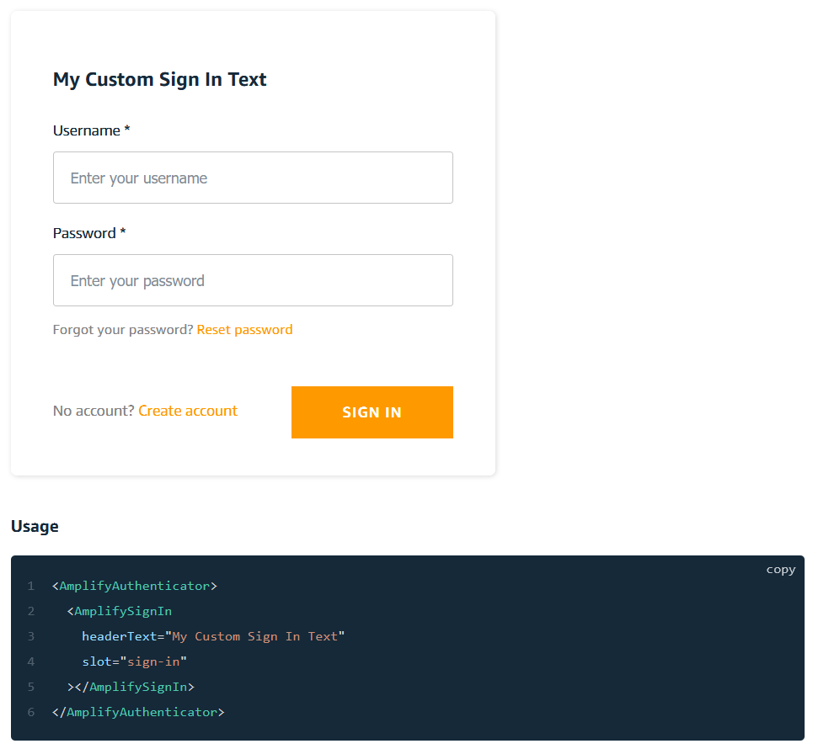
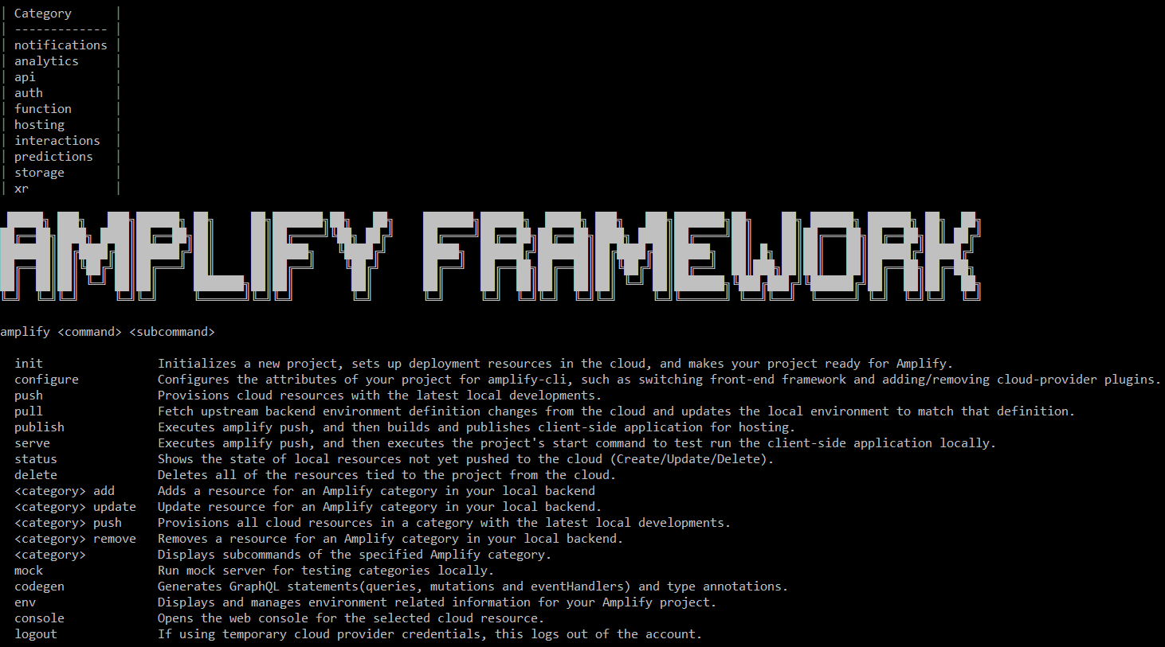
What is Amplify?
An open-source toolset designed to ease the process of setting up AWS backends
Provides the user with a CLI which is used for provisioning backend services
Pre-built UI components allow quick implementation of common systems

Slide 6
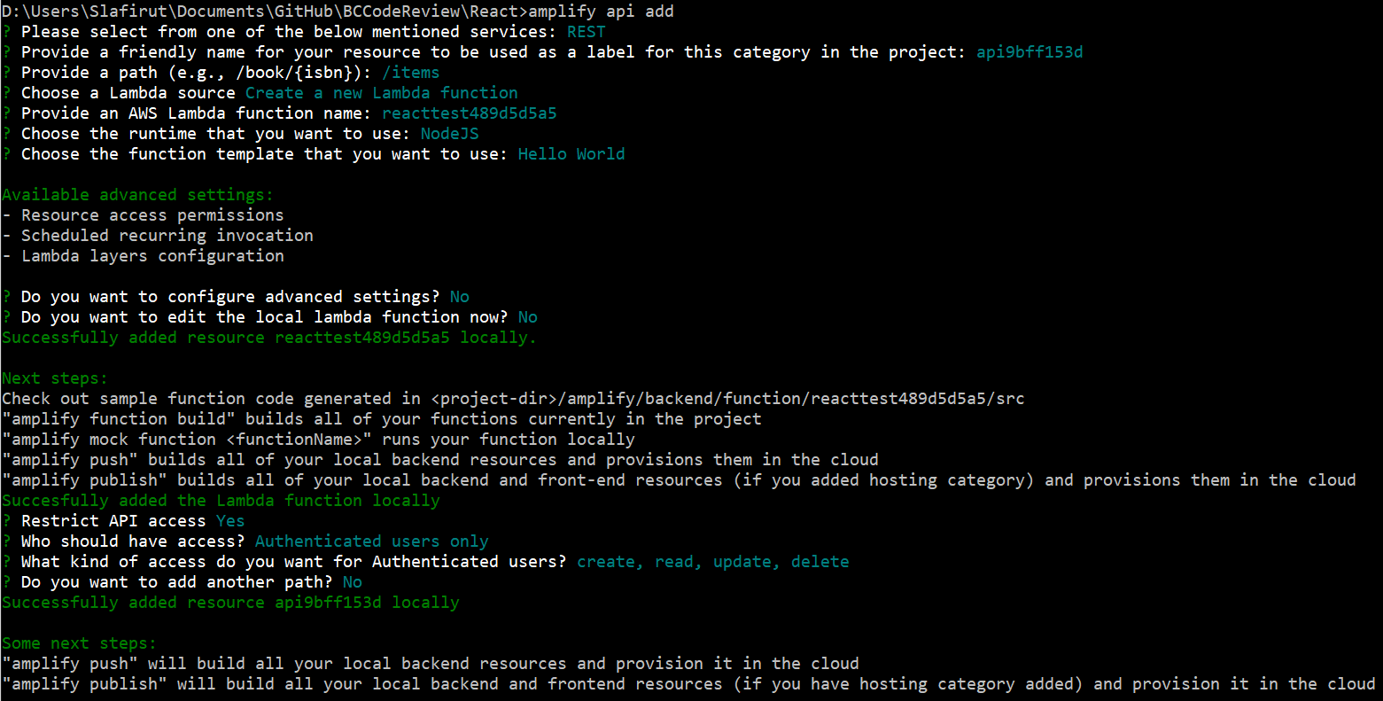
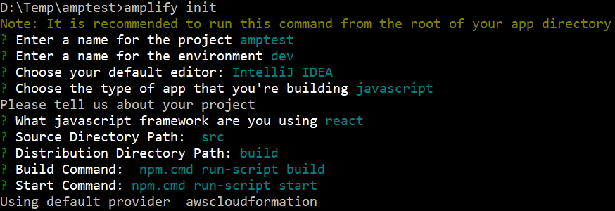
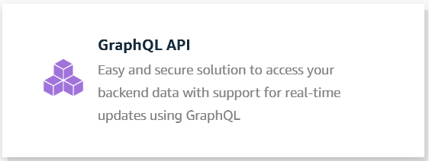
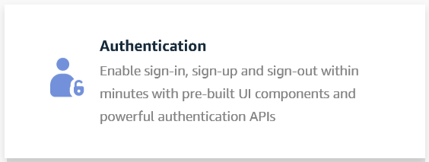
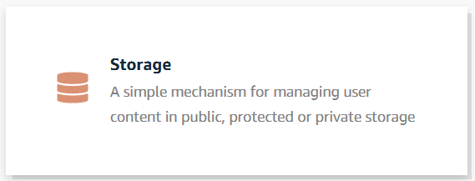
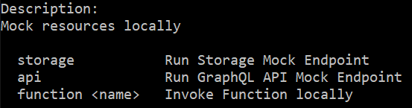
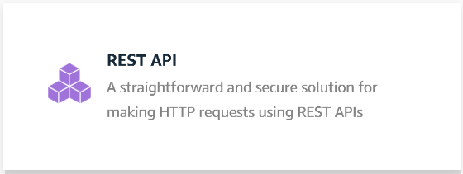
The Amplify CLI
Common commands
amplify init
amplify add
amplify pull
amplify mock
Categories
Auth
API
Storage

Slide 7
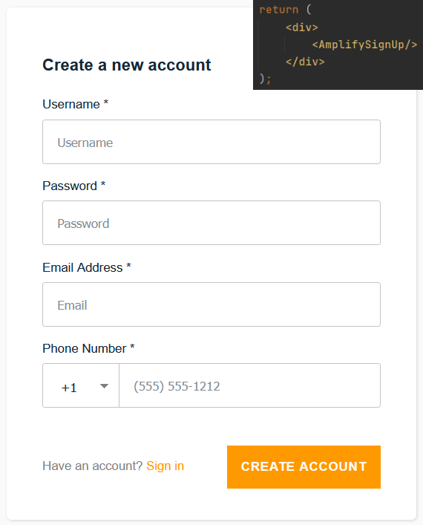
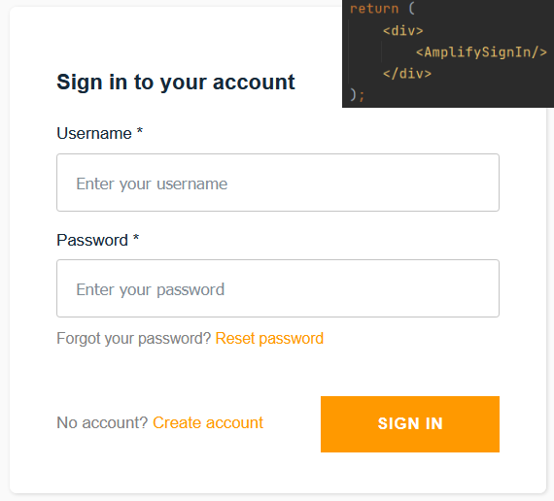
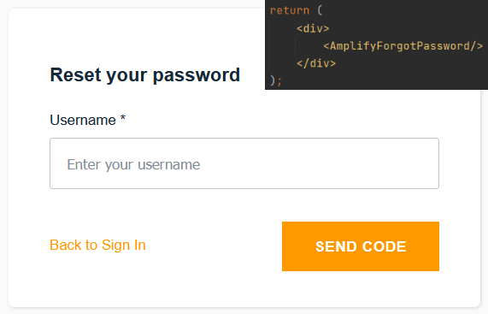
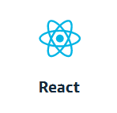


Pre-built UI components
Designed for quick implementation, not necessary
UI components for multiple frameworks (such as React, Angular, Vue)
Auth
AmplifySignUp
AmplifySignIn
AmplifyForgotPassword

Slide 8
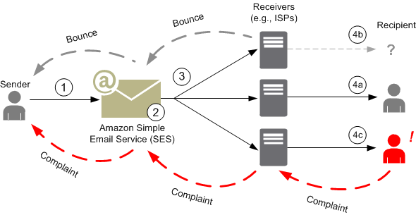
Amazon Simple Email Service (SES)
Pay-per-use service that allows building an email functionality into an application run on AWS
Sends bounces and complaints by email or through Amazon SNS
GitGoing has SES configured to publish notification emails to our website

Slide 9

Simple Email Service (SES)
Email use cases supported by Amazon SES:
Transactional emails
Marketing emails
Bulk email communication

Slide 10
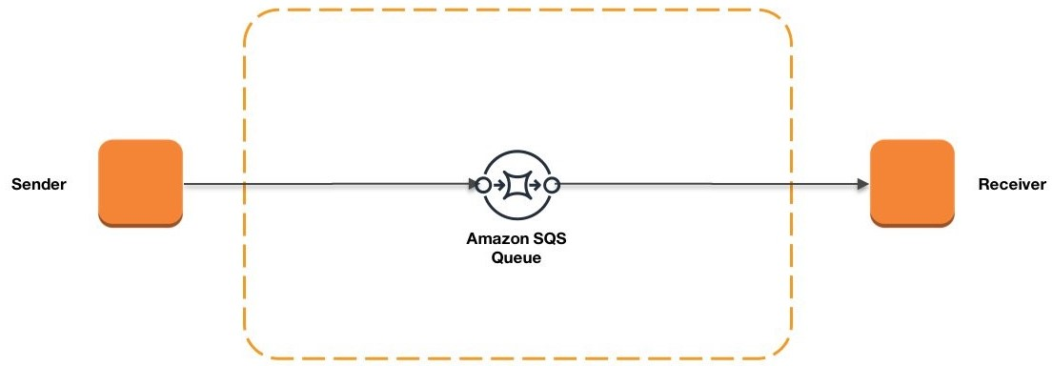
Amazon Simple Queue Service (SQS)
Distributed message queuing service intended to store messages in transit between computers

Slide 11
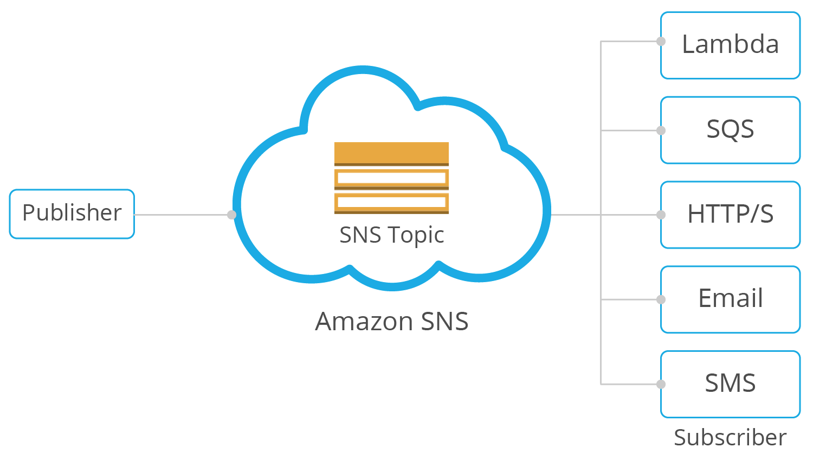
Amazon Simple Notification Service (SNS)
Cloud service for coordinating the delivery of push messages from applications to subscribers.
Network where subscribers can subscribe to topics and will receive messages whenever a publisher publishes to that topic.

Slide 12


SQS vs SNS
Pull architecture
Push architecture
SQS and SNS are configured in GitGoing architecture
They handle bounce and complaint notifications

Slide 13
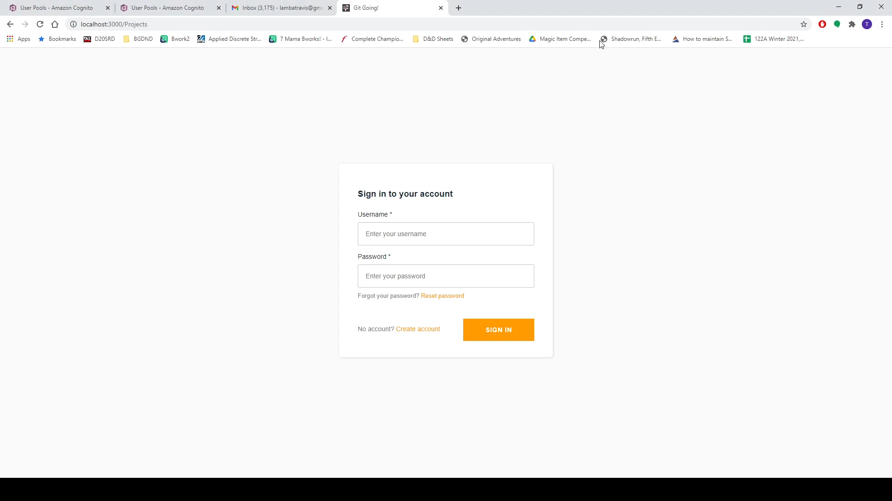
Prebuilt Components vs. Custom Components
Here you’ll see the differences between using Amplify’s prebuilt components and using Amplify’s API calls for custom components.

Slide 14
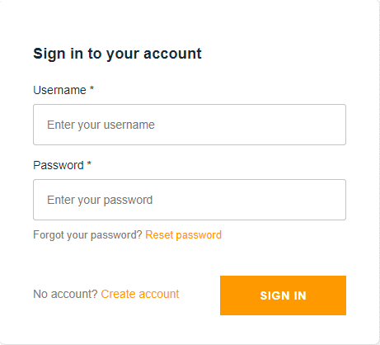

Conclusion
AWS has numerous services that offer a wide variety of utility
Many of the systems play off each other
By focusing on specific tools, one can heavily customize their AWS experience
Despite the ability of Amplify to provide pre-built components, users may also choose to manually implement certain features, allowing for more freedom in development
Documentation is very comprehensive. Don’t get lost.

